Slide 1
Web Tracking Lab
Kailiang

Slide 2
Environment Setup
Start Apache Server
sudo service apache2 start

Slide 3
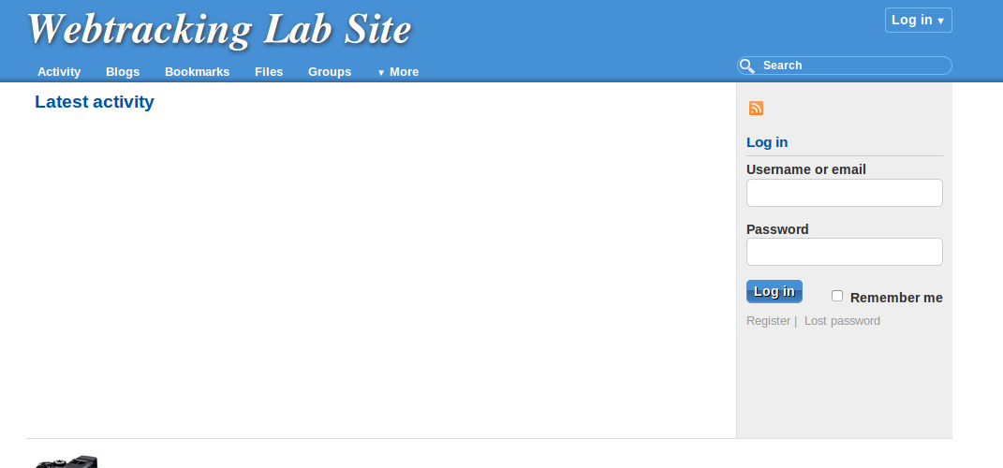
Environment Setup
Elgg Web Application: www.wtlabelgg.com

Slide 4
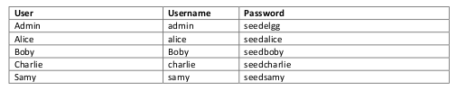
Environment Setup
Elgg Web Application

Slide 5
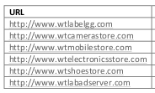
Environment Setup
Websites URL:

Slide 6
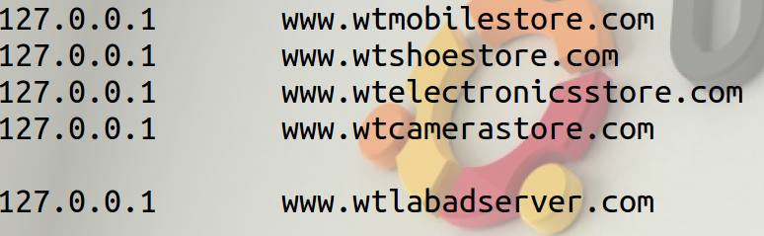
Environment Setup
DNS Configuration
/etc/hosts

Slide 7

Environment Setup
Apache server configuration
/etc/apache2/sites-available

Slide 8
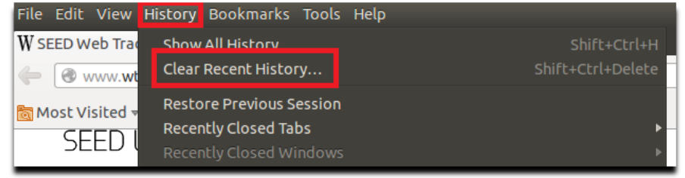
Environment Setup
clear history

Slide 9
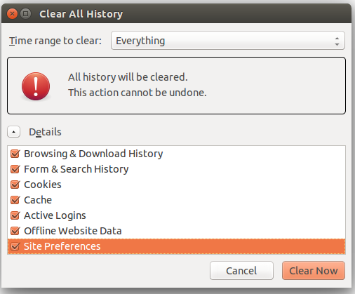
Environment Setup
clear cookies

Slide 10
Task 2A: cookie in web tracking
Open LiveHTTPHeader:
Firefox → tool → LiveHTTPHeader
Purpose:
capture HTTP header of page while browsering

Slide 11
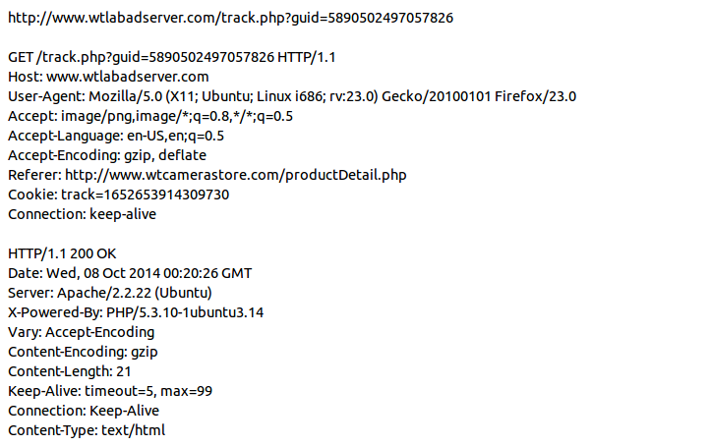
Task 2A: cookie in web tracking
LiveHTTPHeader example:

Slide 12

Task 2B: cookie in web tracking
Open Firebug:

Slide 13
Task 2B: cookie in web tracking
Firebug:
inspect cookie using cookie manager
view cookies own by current page

Slide 14
Task 2B: cookie in web tracking
advanced cookie manager:
Firefox --> tools → add-ons --> advanced cookie manager

Slide 15

Task 6: Real world tracking
Visit each websites
use LiveHTTPHeader/advanced cookie manager to identify 3rd party cookie

Slide 16
Grade Criteria
Task 1: 10 %
Task 2: 20 %
Task 3: 15 %
Task 4: 15 %
Task 5: 15 %
Task 6: 10 %
Task 7: 15 %

